Slide 1
Join transformation

Slide 2
EmpJoinSource1.csv
Eno | Ename | EDeptNum | Role
1 | Ram | 1 | Manager
2 | Sam | 2 | Manager
3 | Bob | 1 | Cleark
4 | Raj | 2 | Admin
5 | Amar | 3 | Developer
6 | Akhil | 1 | Supervisor
7 | Anju | 3 | Support
8 | Anil | 2 | Electrician
9 | Ajay | 2 | Front Desk
10 | Vijay | 3 | Admin

Slide 3
EmpJoinSource2.csv
EDeptNum | DeptName
1 | IT
2 | Sales
3 | Warehouse

Slide 4
Empjoinsource3.csv
EDeptNum | DeptName
1 | IT
2 | Sales
3 | Warehouse
4 | Delivery

Slide 5
Empjointarget.csv

Slide 6
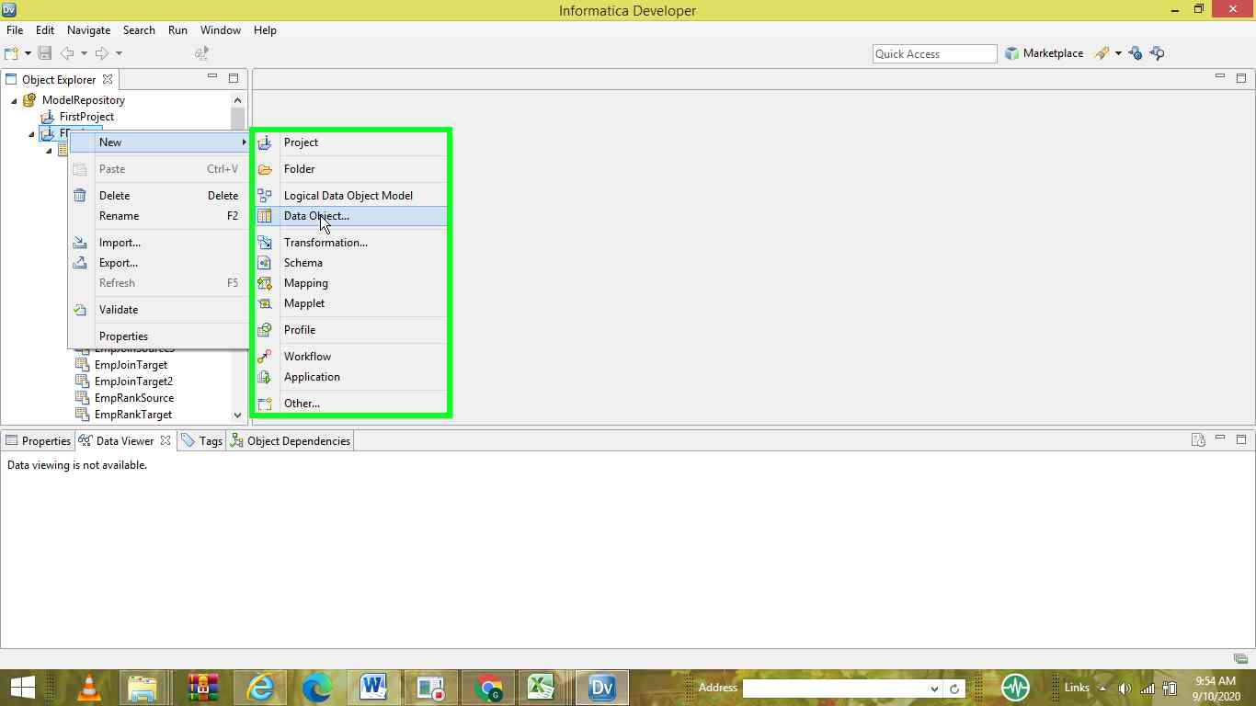

Slide 7
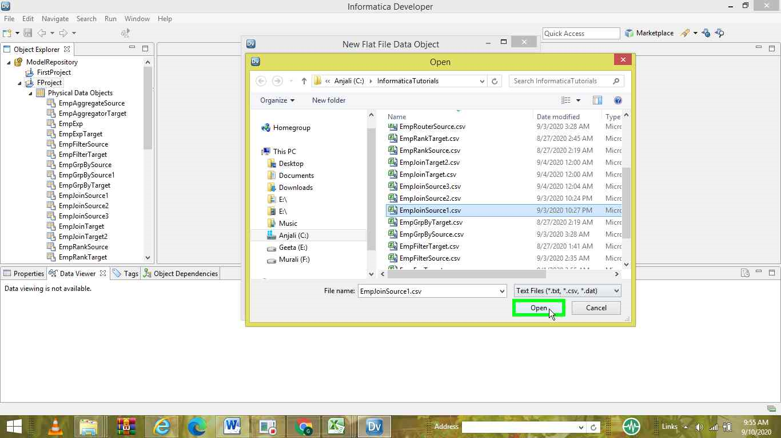

Slide 8
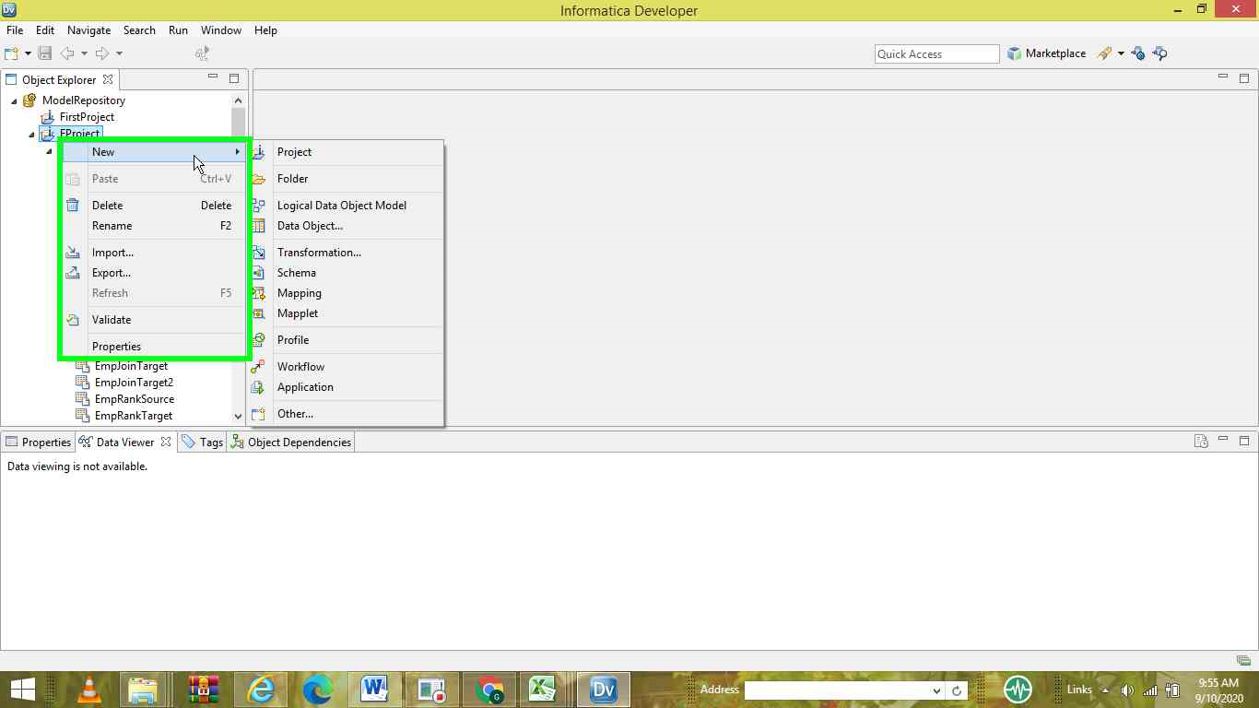

Slide 9
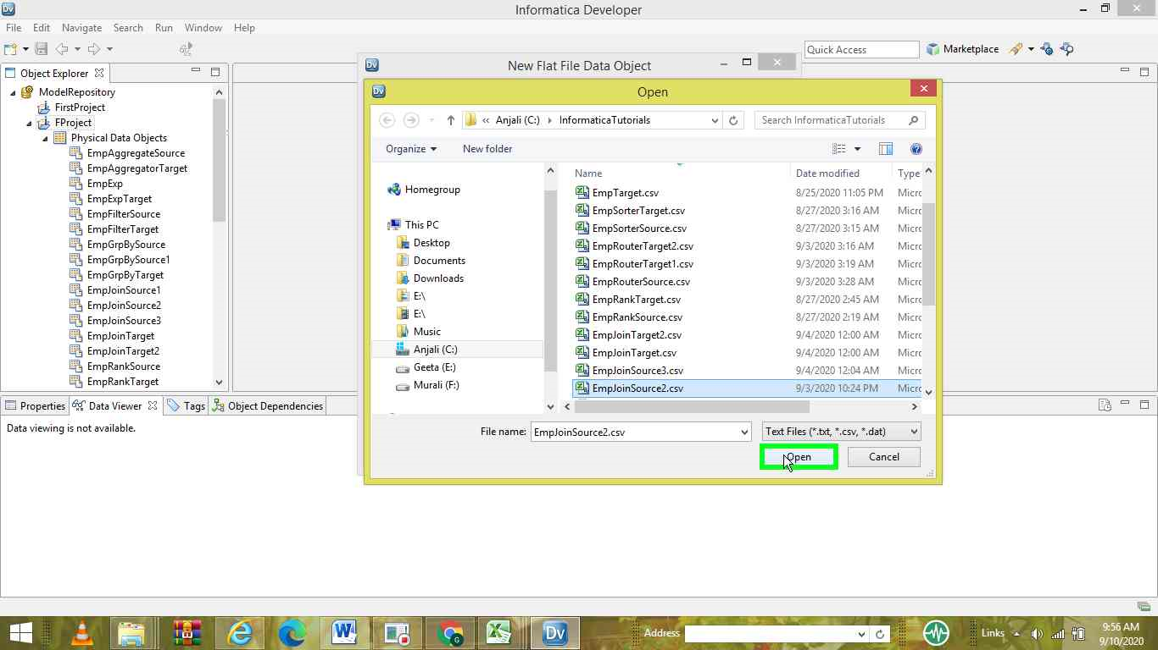

Slide 10
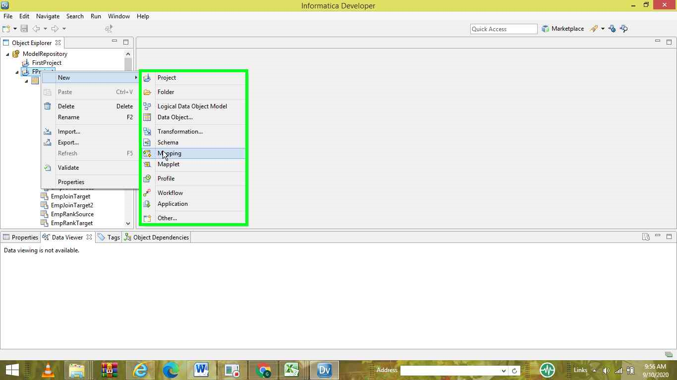

Slide 11
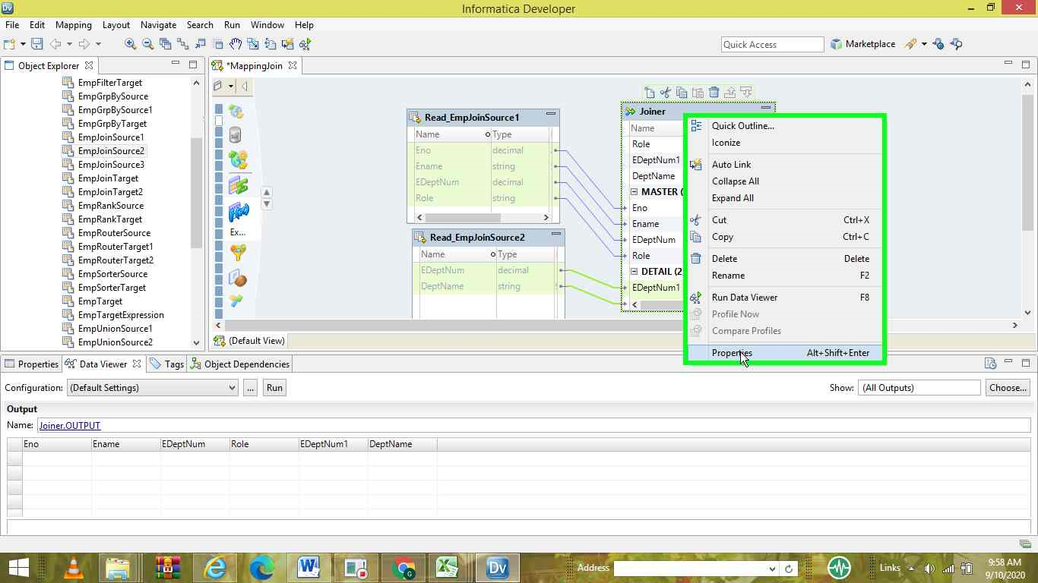

Slide 12
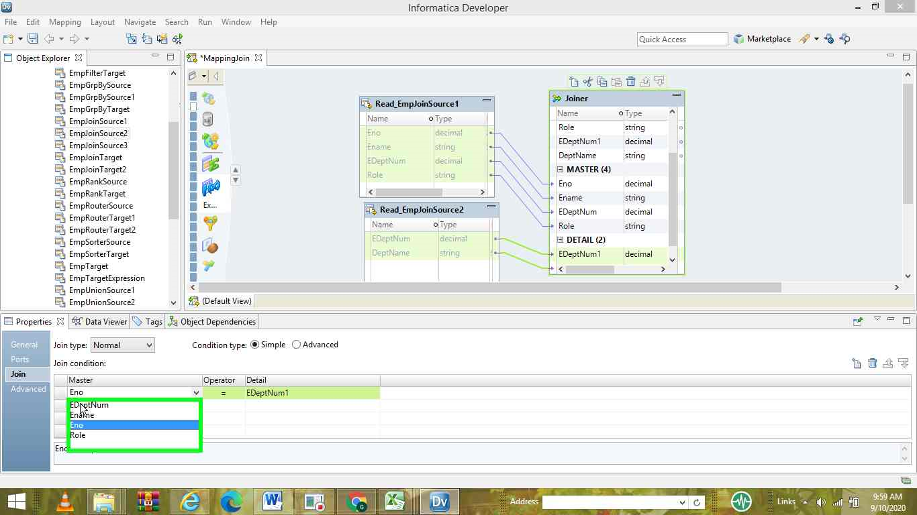

Slide 13
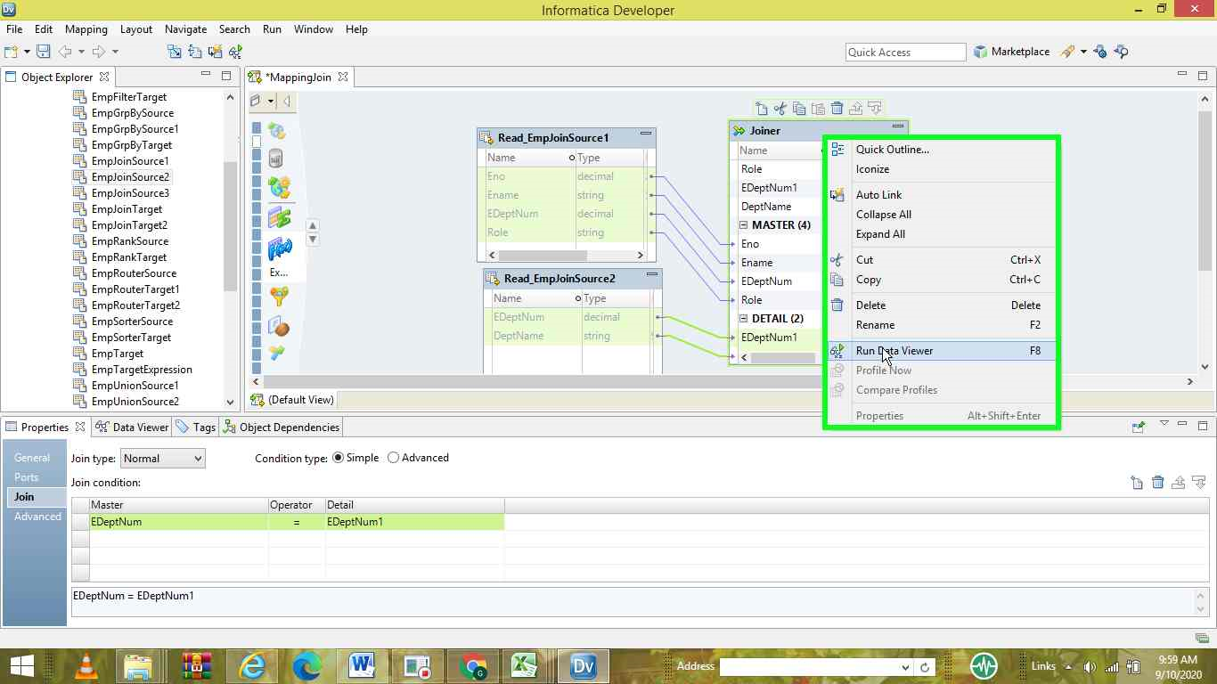

Slide 14
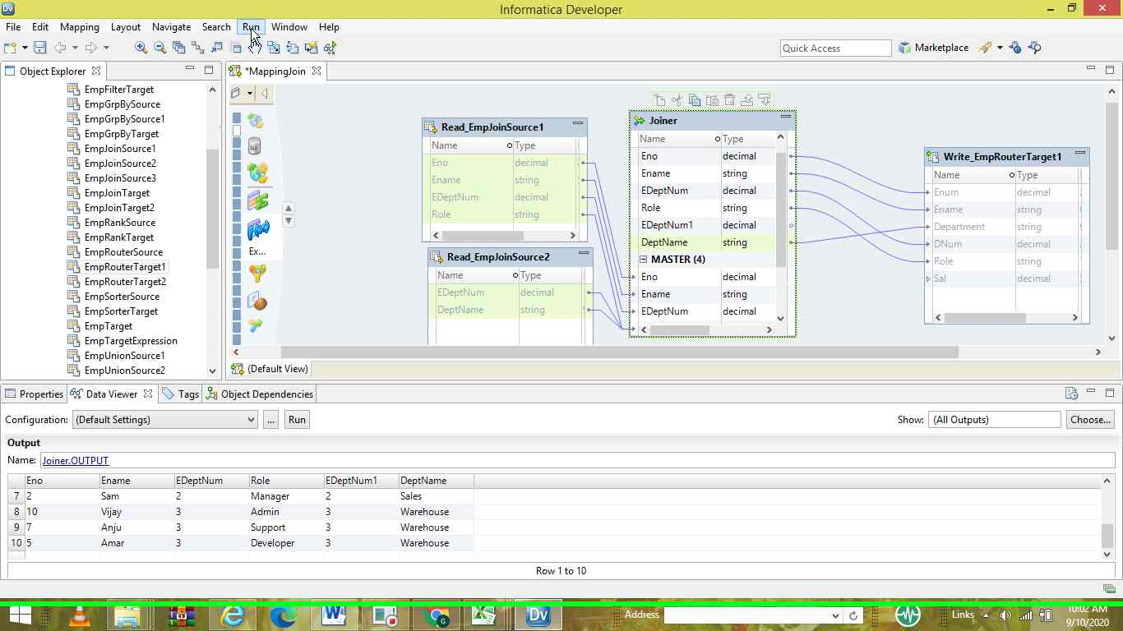

Slide 15
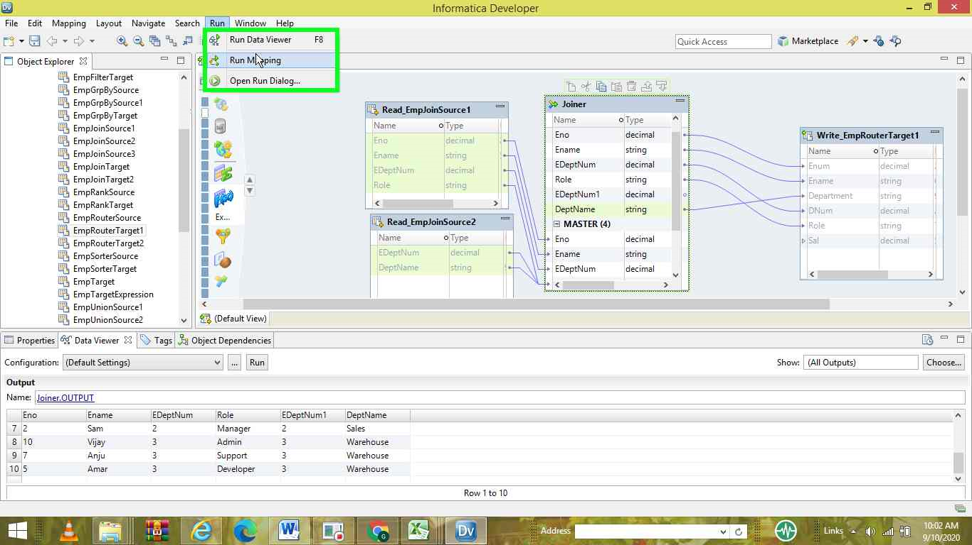

Slide 16
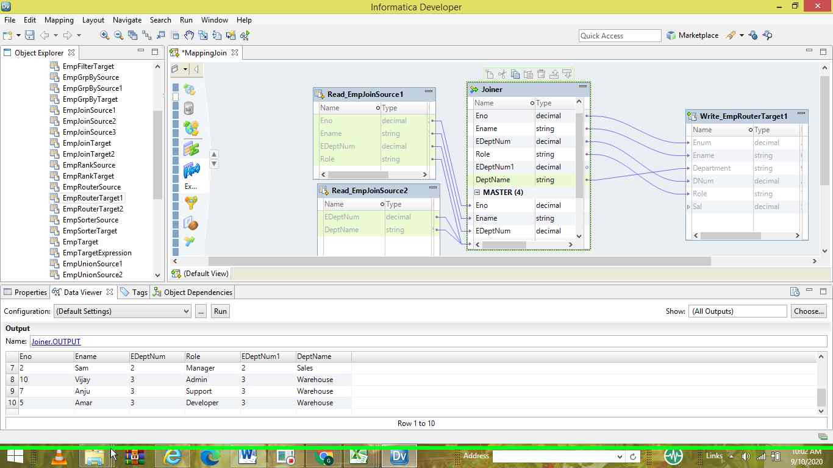

Slide 17
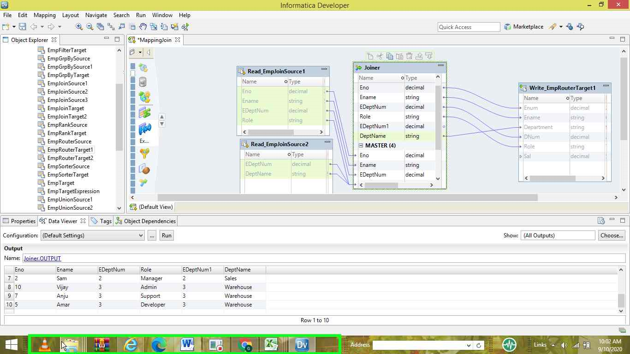

Slide 18
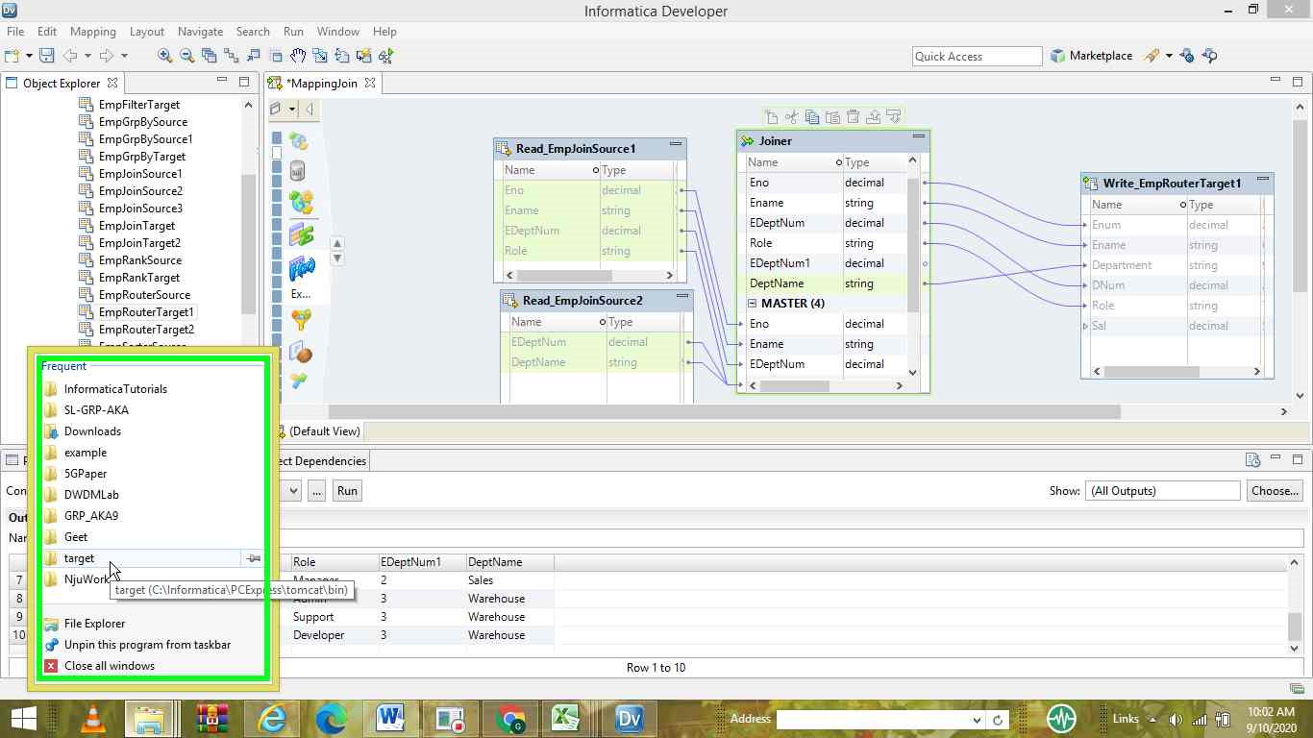

Slide 19
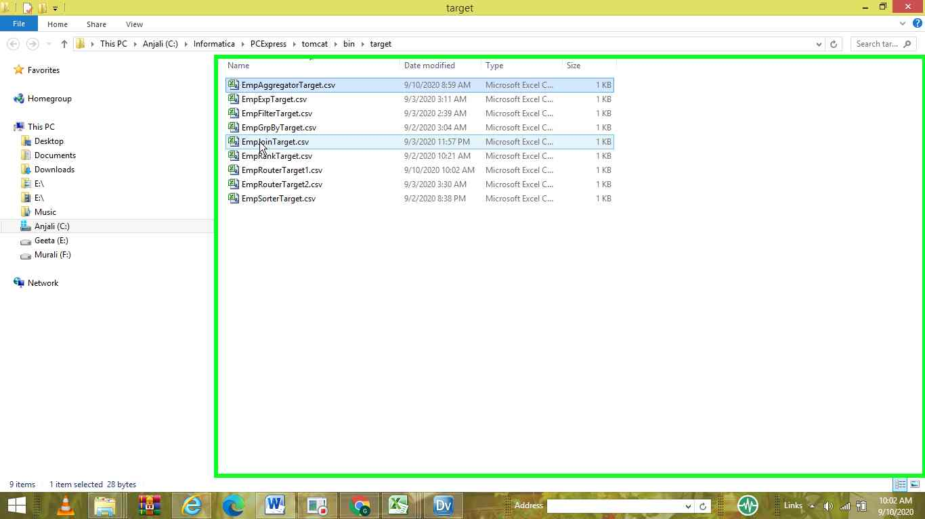

Slide 20
